Slide 1
Marketing Storyboard
Nate Bachmeier. Mrk 571 Marketing. November 28th 2016.

Slide 2



Opening Scene
Student: It’s just so frustrating, I don’t get it!
Teacher: It’s just so frustrating, why don’t they get it!

Slide 3

How Can We Fix This?!?
All of the knowledge is in the cloud, we only need method to access it.

Slide 4
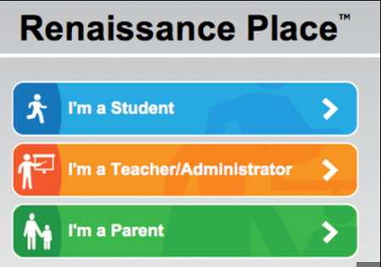
Centralize the Knowledge
Wouldn’t it be great if there was a portal for everyone?
One where all their questions around learning could be answered?

Slide 5

Unleash the Power
Now with Renaissance Education Suite, everyone can find the answers to learning or teaching more efficiently

